Slide 1
DIGITAL BANK
Group Number – 2
Team Lead – Shivam Mishra

Slide 2
AGENDA
01
Introduction
Primary Goals
Why Maven?
Technologies
Screenshots
Outcomes
Advantages
Conclusion

Slide 3

INTRODUCTION
OBJECTIVES
Creating Test Scenarios: We'll make detailed plans to check every part of the digital banking app. This way, we can be sure that it works well and doesn't have any problems.
2.Using Automation: We'll use special tools to help us test the app. These tools make testing faster, more accurate, and cover more things. They also reduce the chance of human mistakes.

Slide 4
PRIMARY GOALS
Test Scenarios
Navigate to the URL, Click on the Signup. Fill in the Personal Details to register. Validate the successful registration.
Navigate to the URL, enter the username, password and click login. Read the multiple username and password from the Excel Sheet.
Navigate to the URL, click on the deposit, choose the account for deposit, and enter the deposit amount then click submit.
Navigate to the URL, click on the withdraw, choose the account for withdraw and enter the withdraw amount then click submit.
Purpose Statement

Slide 5

Navigate to the URL, click on the transfer between accounts, choose the From Account and To Account then enter the transfer amount and click submit.
Navigate to the URL, click on the Visa Transfer, choose the Visa Account Number, and enter the transfer amount then click submit to VISA.
Navigate to the URL, click on the Checking>>View Checking, enter the TRN number on search box.
Navigate to the URL, click on the Saving>>View Saving, enter the TRN number on search box.

Slide 6


Why Maven?
Maven is a powerful build and project management tool that simplifies dependency management.
It uses a project object model (POM) file to define dependencies, and it automatically downloads and manages the required JAR files from a central repository.
This makes it much easier to handle complex projects with many dependencies.
When to Choose a Maven Project?
Choose a Maven project when you have a complex Java project with multiple dependencies,
need automated build and testing processes, and want to benefit from standardized project structures and dependency management.
It's especially valuable for enterprise-level applications and large software projects.

Slide 7
TECHNOLOGIES
JAVA
Selenium WebDriver
Testng
Cucumber
Framework
Log4j
Extent Reports

Slide 8


JAVA - Java is a widely used programming language in test automation. It provides a robust and versatile platform for developing automation scripts. Java is known for its portability, thanks to the "Write Once, Run Anywhere" (WORA) principle.
Selenium Web driver:
Selenium WebDriver is a powerful tool for automating web application testing, and its flexibility, support for multiple programming languages, and cross-browser compatibility make it a popular choice for test automation in both manual and automated testing environments.
Key characteristics and features of Selenium WebDriver include:
1)Locators
2)Explicit Wait
3)Screenshots
4)Mouse and Keyboard Actions
5)Logging

Slide 9


TestNG Annotations:
TestNG annotations are metadata tags or labels in the TestNG testing framework used to provide instructions, configuration, and control over the execution of test methods and test classes. They define the behavior, order and conditions under which tests are run, allowing for flexible and organized test automation.
@Test
@BeforeSuite @AfterSuite
@BeforeTest @AfterTest
@BeforeClass @AfterClass
@BeforeMethod @AfterMethod

Slide 10

Assertions in TestNG
An assertion in TestNG is a statement or method that checks if a given condition or expression is true during the execution of a test case. If the condition is true, the test continues to execute;
if the condition is false, the test fails, and further test steps are halted.
assertEquals,
assertNotEquals
assertTrue
assertFalse
assertNull
assertNotNull

Slide 11


TestNG Listeners
TestNG listeners are callback interfaces or classes that enable you to intercept and respond to events that occur during the execution of TestNG test suites and test cases.
They provide a way to implement custom actions, logging, or reporting based on the outcome and progress of tests.
ITestListener interface methods
OnTestSuccess
OnTestFailure
OnStart
OnFinish
OnTestSkipped

Slide 12
Cucumber :
Cucumber is a widely-used open-source software tool and framework that facilitates the practice of Behavior-Driven Development (BDD)
It allows software development teams to write and execute tests in a natural language format, making it easier for both technical and non-technical stakeholders to collaborate and understand the behavior of a software application.
Key Features of Cucumber:
Gherkin Syntax:
Feature Files
Scenario Outline
Step Definitions
Hooks
Reporting
Integration

Slide 13
Framework:
Data-Driven Framework:
Data-Driven Testing is a testing approach that uses external data sources to parameterize and drive test scripts, enabling the execution of the same test with multiple sets of data."
Components of a Data-Driven Framework
Test Data
Test Scripts
Test Framework
Data Source
Test Runner
Reporting

Slide 14
Log4j properties:
The log4j.properties file is a configuration file used in the Log4j logging framework to define how log messages should be handled and where they should be logged.
log4j.rootLogger=ERROR,stdout
log4j.logger.com.endeca=INFO
log4j.logger.LogDemo=DEBUG, dest1
Extent Reports:
Extent Reports is a reporting library widely used in the context of test automation to enhance and streamline the reporting of test execution results.
Its primary purpose is to provide comprehensive, interactive, and visually appealing reports that make
it easier for teams to understand and analyze the outcome of automated tests.

Slide 15
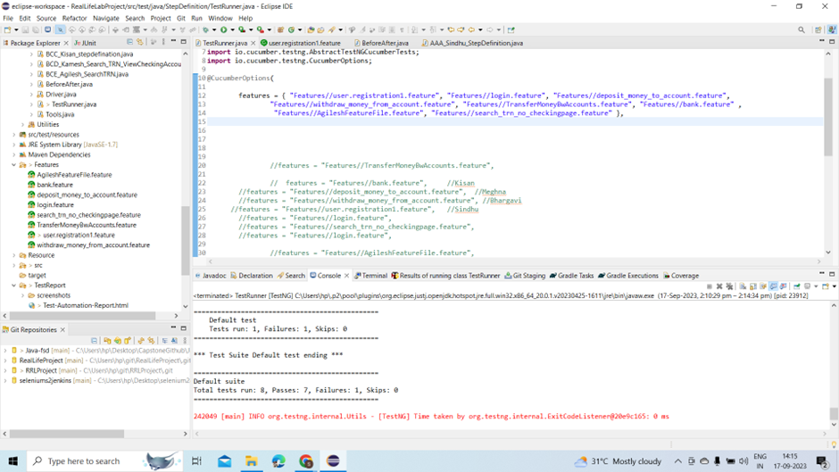
OUTPUT SCREENSHOTS

Slide 16


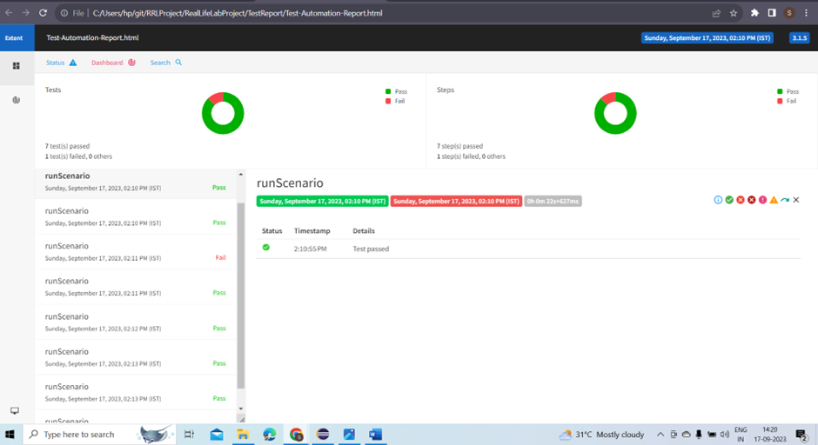



EXTENT REPORT

Slide 17


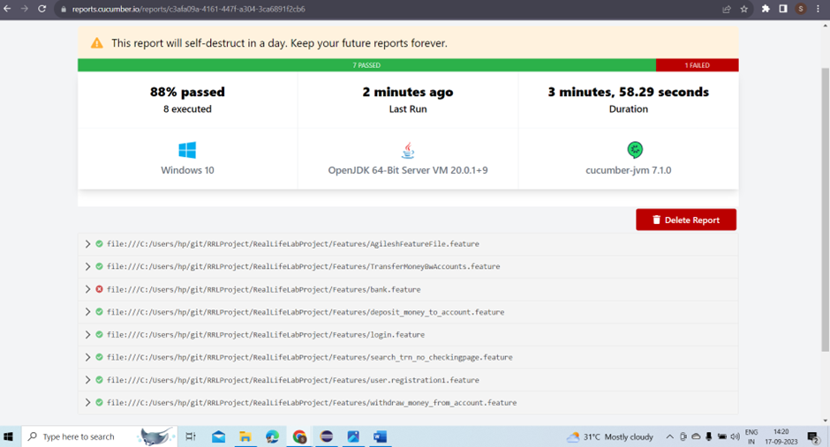
CUCUMBER REPORT

Slide 18

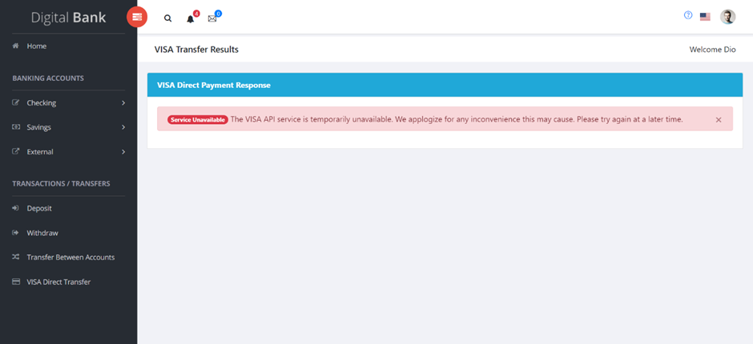


FAILURE SCREENSHOT

Slide 19
OUTCOMES:
During our testing of the application, we discovered that it performed well in various aspects, including sign-up, sign-in, deposit, withdrawal, and searching by TRN number in both checking and savings accounts.
However, we encountered an issue where the application was not functioning when attempting Visa Direct Transfers.
Additionally, one notable drawback of the application is its occasional tendency to unexpectedly return users to the login page.

Slide 20
ADVANTAGES
Testing plays a crucial role by identifying vulnerabilities, security flaws, usability issues, bugs, and performance bottlenecks in the application, ultimately enhancing security, user experience, and reducing downtime.
We use Excel to try out different situations automatically. This means we can test many things at once, which would be too time-consuming to do by hand.

Slide 21

Double-Checking Everything: We have special checks in our tests to make sure the website is behaving just the way we expect it to. This gives us confidence in its performance.
If something goes wrong during a test, we automatically take a picture of the screen. This helps us understand exactly what happened and fix it faster.
After each test, we create easy-to-read reports. These reports show what worked well and what didn't. They help us and our team understand the results.

Slide 22
Conclusions
01
02
03
Our testing revealed that the application demonstrated strong performance in key areas
It has a major issue with Visa Direct Transfers, and sometimes it randomly takes users back to the login page.
Fixing these problems would make the app even better.

Slide 23

ThankYou!

